Slide 1

Distributor Compliance Presentation
[DRO Name]

Slide 2
Agenda
1
Welcome and Purpose
2
Message from Kim Tyrrell-Knott, VP Chief Compliance Office
3
MiniMed Distributor Compliance Requirements
4
Reporting Concerns and Support Resources
5
Q&A and Final Thoughts

Slide 3
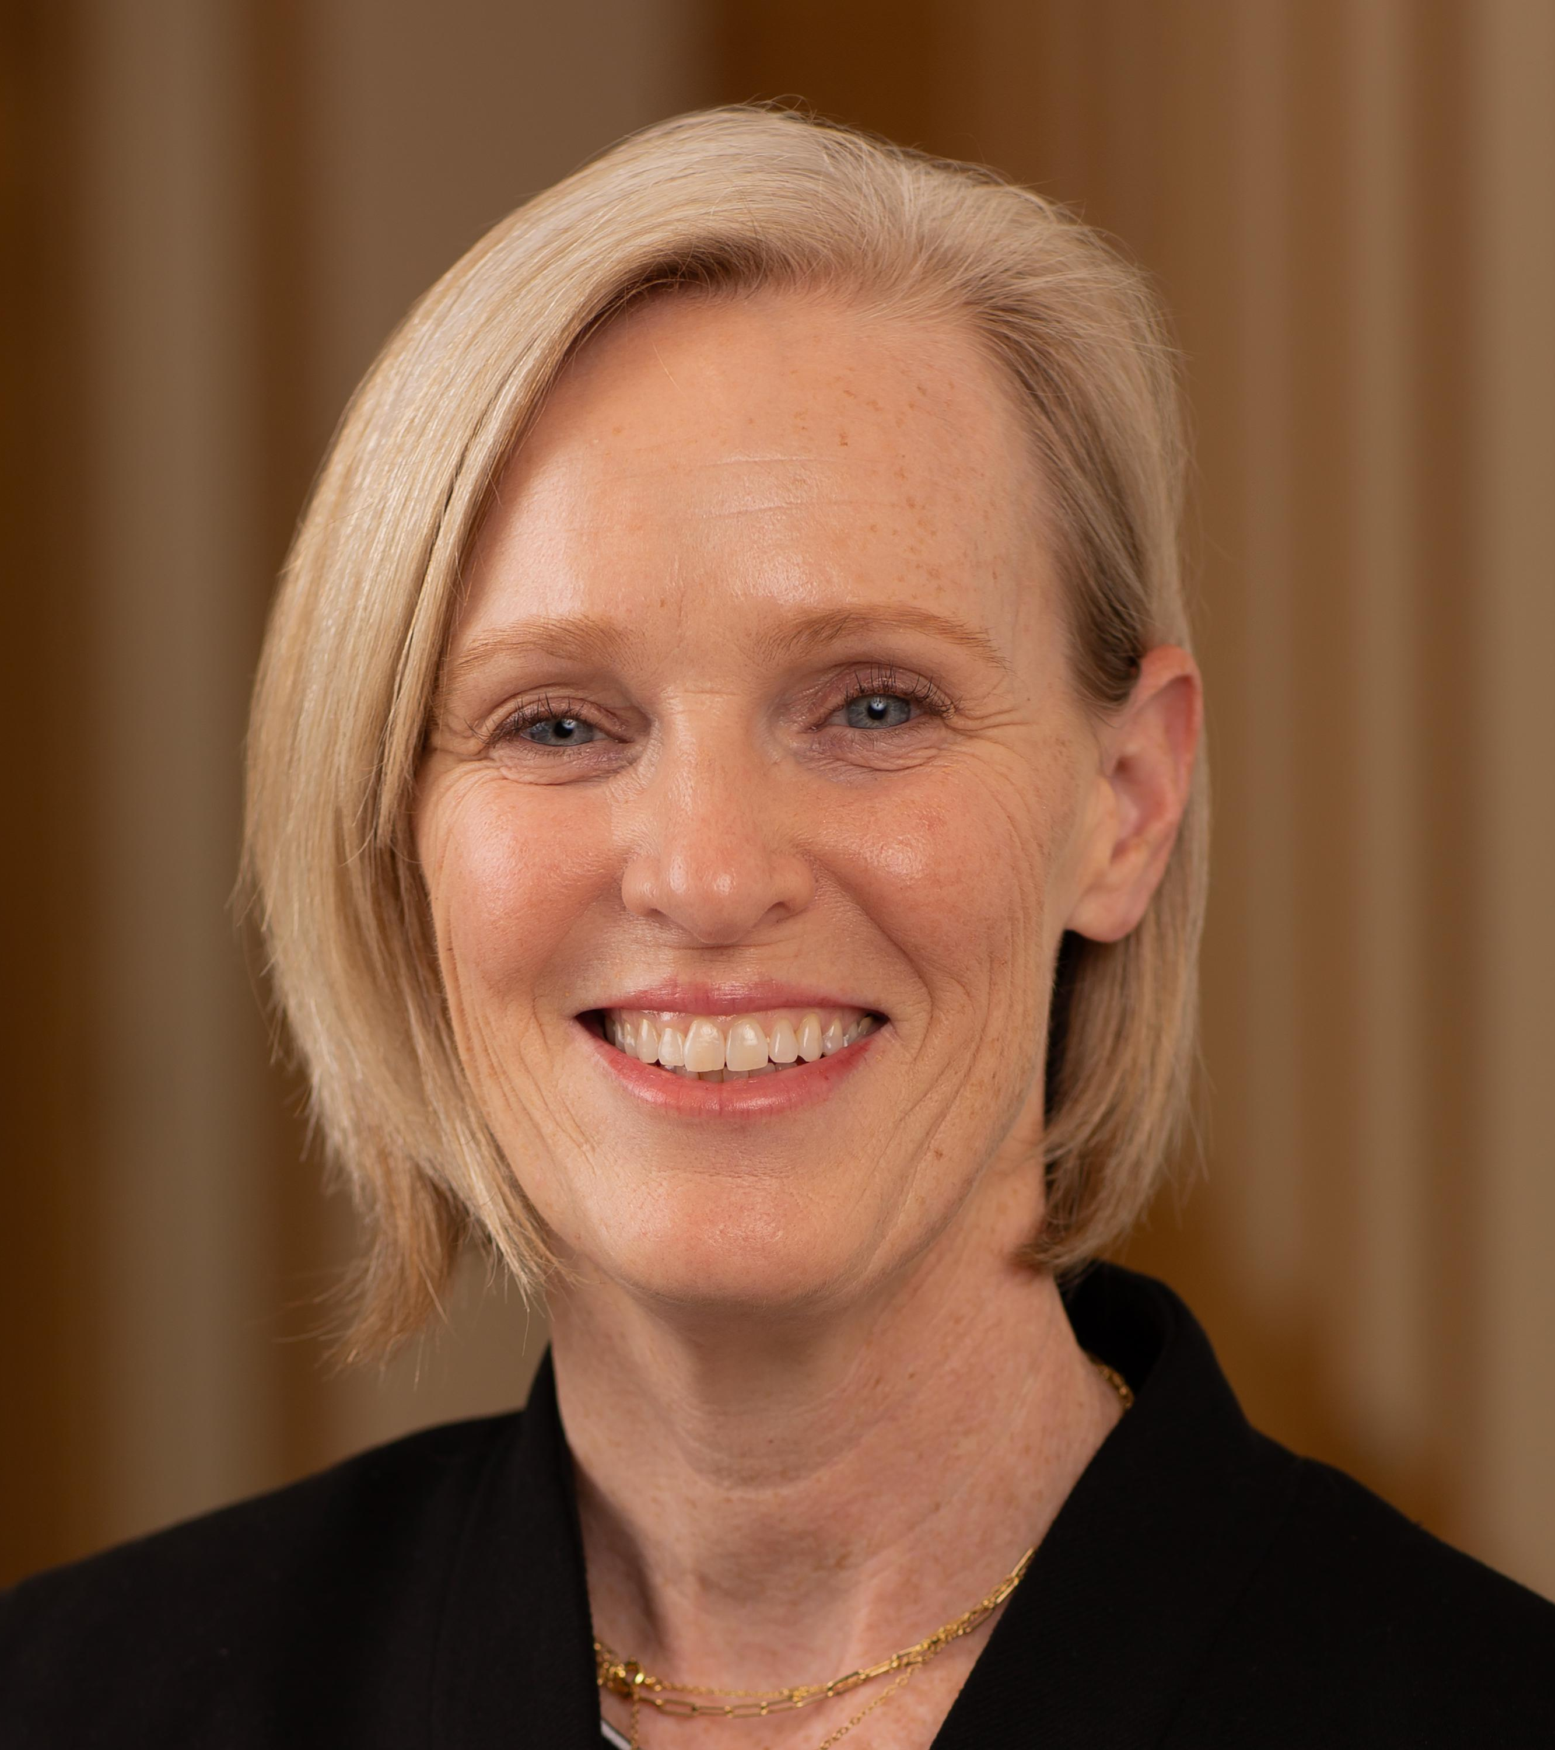
Message from the Chief Ethics & Compliance Officer
“MiniMed is committed to maintaining the highest standards of ethics and compliance in all areas of our business. We rely on strong, responsible partnerships to ensure adherence to international regulations, local anti‑bribery laws, industry codes, and our own code of conduct. Thank you for your continued support in upholding these standards.
Thanks for your support in upholding these standards.”
Kim Tyrrell-Knot
Distributor Compliance Presentation - Public

Slide 4
Our Compliance Requirements

Slide 5
Compliance Requirements
1
2
3
4
5
6
Compliance Leader & Policy
Compliance Training
Sub-distributors
Books
and Records
Reporting Quality Issues
Conflicts
of interest
Distributor shall appoint a senior officer to take the role of responsible compliance leader.
Distributor shall adopt and maintain a compliance policy, substantially equivalent to the model Code of Conduct .
Distributor shall ensure that all its employees or sub-distributors who interact, or support interaction, with customers undertake compliance training.
Distributor must inform MiniMed of the use or intent to use sub-distributors who trade MiniMed product, perform due diligence, and train them on MiniMed requirements.
Distributor shall maintain complete and accurate records concerning all transactions.
Distributor shall submit to MiniMed, in writing or such other form as MiniMed may specify, an inventory and in-market sales report by units of products.
Distributor must comply with all quality and regulatory requirements established under applicable laws.
Distributor must disclose and avoid apparent conflicts of interest with its customers or with MiniMed

Slide 6
Responsible Compliance Leader
Key Elements
Points to Consider
The responsibilities of the role are as follows:
  Implement and oversight of compliance obligations
  Point of contact to internal employees and MiniMed
  This role may be in addition to other responsibilities (For example: Legal Counsel; HR or Finance Manager)
  Ensure appropriate seniority
Has your distributor designated a senior person to serve as its Responsible Compliance Leader?
Is this person familiar with the compliance and quality obligations per the agreement?
Does this person keep updated on compliance requirements changes?

Slide 7
Compliance Policy
Key Elements
Points to Consider
Reference Materials
Written and communicated to employees
It must cover the following areas:
  Meals and hospitality
  Donations
  Consulting agreements
  Healthcare Professional education
  Tenders
  Samples and free goods
  Gifts
  Conflicts of interest
  Use of sub-distributors
International or local industry codes to be observed
Has your distributor adopted a Code of Conduct, either the model Code provided in our website, or a substantially equivalent one?
Has the code, and its limits and rules been communicated to the distributor´s employees and agents who sell MiniMed products?
Sample Code of Conduct
Do´s and Don’ts
Distributor Employee Training Attendance Form
Access them all here.

Slide 8
Compliance Training
Key Elements
Points to Consider
Reference Materials
Training by MiniMed or its designated association, or training organized by distributor
MiniMed can facilitate access to Compliance training resources
Content provided by MiniMed or its designated association in its discretion, or equivalent
Maintain records and copies of the content of training.
Has your distributor´s compliance leader attended any compliance training organized by MiniMed?
Has your distributor provided compliance training to its employees and sub distributors?
Is the content of the training provided that of MiniMed or similar?
Does your distributor maintain written records of which employees or sub-distributors have been trained and when they were trained?
Do´s and Don’ts
Distributor Employee Training Attendance Form
Access them all here.

Slide 9
Sub-distributors
Key Elements
Points to Consider
Reference Materials
Provide MiniMed the Notification on Use of Sub-Distributors completed form, if applicable
Partners should be screened
Written agreements must include compliance and audit clauses in the same manner and standard as the agreement with MiniMed.
Share the MiniMed Distributor Code of Conduct
Does your distributor use sub-distributors to sell MiniMed products?
Did your distributor notify MiniMed?
Does your distributor conduct due diligence for any sub- distributors to ensure they do not present a corruption risk?
Does your distributor require a written agreement?
Does your distributor ensure sub-distributors are complying with all our compliance and quality requirements?
Notification on Use of
Sub-distributors
Due Diligence Quick Check
Do’s and Don’ts
Sample Code of Conduct
Access them all here.

Slide 10
Books and Records
Key Elements
Points to Consider
Reference Materials
Maintain purchase, sales, marketing expense and training program records for the period established in the agreement and according to local law
Provide MiniMed (or its designated representative) with full and unrestricted access
Submit an inventory and in-market sales report by units of Products upon request
Does your distributor have qualified accounting staff to maintain its financial records?
Is your distributor aware of the requirement to provide full access to MiniMed-related records upon request?
Has your distributor been asked to submit an inventory and in-market sales report by units of products and, if so, have they submitted that information on time?
Does your distributor have a way to segregate records for MiniMed transactions?
Expense Reimbursement Form
Samples Request Form
Sponsorship Agreement
Consulting Agreement Notification Letter to HCP’s Employer
Do’s and Don’ts
Access them all here.

Slide 11
Quality Considerations
Key Elements
Points to Consider
Reference Materials
Notify MiniMed of any product complaints no later than 48 hours through the reporting tool mPXR
Execute any action required by MiniMed to implement a field corrective action
Ensure product traceability
Do not alter the packaging nor relabel the product and store them in the specified condition
Do not promote use other than the manufacturer labeling or instructions
Is your distributor familiar with the complaint reporting tools?
Has your distributor trained its employees on the quality/regulatory requirements?
Does your distributor promote use other than the manufacturer labeling or instructions?
Do your distributor´s storage facilities meet our requirements?
Does your distributor use a system to track products?
Has your distributor executed any action required by MiniMed to implement a field corrective action?
Quality Guidelines

Slide 12
Conflicts of Interest
Key Elements
Points to Consider
Reference Materials
Disclose personal relationships with customers, government officials or MiniMed employees
Disclose business relationships (other than those necessary to fulfill contractual requirements with MiniMed) with customers, government officials or MiniMed employees
Disclose ownership, other investment interests or any compensation received from a customer
Disclose any other information regarding a situation that may present a real or perceived conflict of interest
Is your distributor familiar with what a conflict of interest is?
Is your distributor aware of any conflicts of interest with their customers or with MiniMed?
Does your distributor train its employees and sub-distributors on conflicts of interest?
Has your distributor informed MiniMed of any actual or potential conflicts of interest?
Is your distributor aware of the MiniMed "Voice Your Concern Line" helpline?
Do’s and Don’ts
Conflict of Interest Declaration
Distributor Employee Training Attendance Form
Access them all here.

Slide 13
Final thoughts
Your MiniMed Contact for Compliance
[DRO Name]
[DRO Title]
[DRO E-mail address]
Reporting a Concern
Distributor employees must report any conduct related to MiniMed that they believe to be a violation of policy or law through their management, the MiniMed Hotline (VOICE YOUR CONCERN Line), and MiniMed Legal or Channel Compliance.
“Voice Your Concern Line” Website and helpline:
Toll free hotline number: +1-833-831-0635
Voice Your Concern
Our partnership is important to us
As a global leader in medical technology, services and solutions, MiniMed is committed to maintaining the highest standards of integrity in all business practices.
As our partner, in serving the healthcare needs of our customers, we are confident that you share our compliance and integrity goals.
Your support of this program and continued collaboration is appreciated.

Slide 14
Global Channel Compliance Contacts
Global Compliance Program Lead Philippa Montgomerie, VP Ethics & Compliance Officer Global Regions (Watford, UK) philippa.montgomerie@MiniMed.com
EMEA Vera Ivanenko, Regional Lead (Moscow, Russia) judith.verkooijen@medtronic.com Abigail Martinez (Luxembourg) m.guadalupe.abigail.martinez@medtronic.com Walid Fahim (Dubai, UAE) walid.fahim@medtronic.com | Americas (LATAM) Hector Romero, Regional Lead (Mexico City, Mexico) hector.romero@medtronic.com
Asia Pacific Jac Lim, Regional Lead (Singapore) jac.lim@medtronic.com Nobuaki Tanaka (Tokyo, Japan) nobuaki.tanaka@medtronic.com Yann Shuang Lee, (Singapore) yann.shuang.lee@medtronic.com | Greater China Jing Zhao, Regional Lead (Shanghai, PRC) jing.zhao2@medtronic.com Gemma Chen, Compliance Specialist (Shanghai, PRC) gemma.chen2@medtronic.com Vera Wu, Associate Compliance Specialist (Shanghai, PRC) vera.wu@medtronic.com Wenjin Li, Compliance (Shanghai, PRC) wenjin.li@medtronic.com
Global Compliance Program Central Team Kim Tyrrell-Knot, VP Chief Compliance Office kim.tyrrell-knott@medtronic.com Paola Samaniego, Sr. Compliance Program Manager (Lima, Peru) paola.samaniego@medtronic.com Lali Mesanza, Sr. Compliance Program Manager (Barcelona, Spain) eulalia.mesanza.costa@medtronic.com George Deden, Compliance Program Manager (Minneapolis, MN, USA) george.c.deden@medtronic.com

Slide 15
Thank you

